Slide 1

JobLink – Your Next Career Journey
A cutting-edge, role-based job portal designed to connect talent with opportunity.

Slide 2

Platform Overview: Connecting the Dots
Role-Based System
Tailored experiences for Job Seekers, Employers, and Administrators, ensuring relevant functionalities for each user type.
Dedicated Dashboards
Each role gets a personalized dashboard for efficient navigation and quick access to critical information.
Comprehensive Features
From job search and applications to candidate management and analytics, JobLink covers the full recruitment lifecycle.
Seamless Experience
Integrated notifications, robust user profiles, and a fully responsive design across all devices.

Slide 3
Our Vision: Goals for JobLink
Empower Job Seekers
1
Streamline the job search and application process, making it intuitive and effective.
Equip Employers
2
Provide powerful tools for job posting, applicant tracking, and efficient candidate management.
Strengthen Admin Control
3
Enable administrators to monitor platform quality, ensure compliance, and maintain a high-standard user environment.
Deliver Modern UX
4
Guarantee a smooth, responsive, and visually appealing user experience on any device.

Slide 4
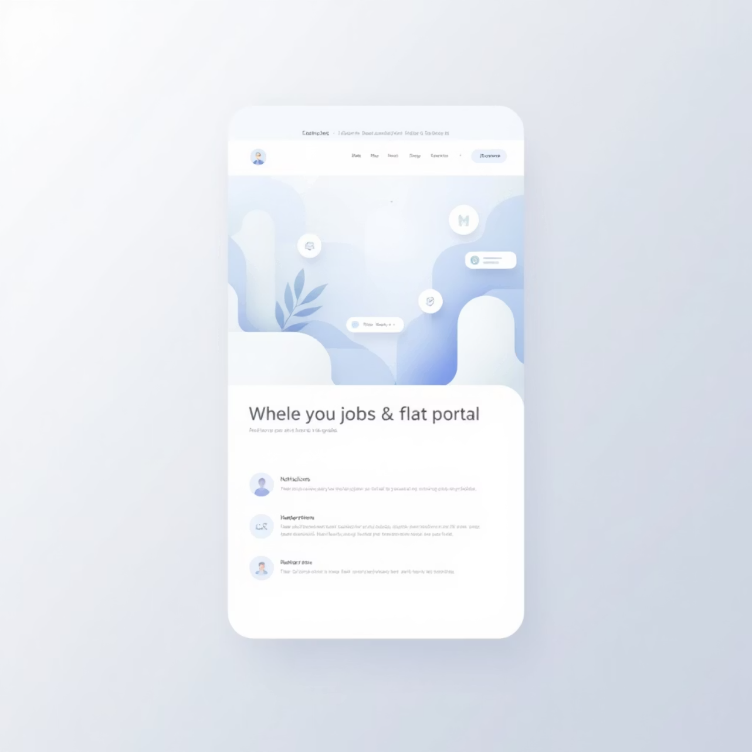
Intuitive Navigation: Global Accessibility
Key Navigation Elements
Top Navbar: Features prominent logo and direct link to the Dashboard.
Role-Based: Ensures users see only relevant options, optimizing their workflow.
Notifications Bell: Keeps users informed with real-time updates.
Profile Dropdown: Easy access to Profile, Settings, and Logout options.
Mobile-Responsive: A collapsible menu ensures seamless usability on smaller screens.

Slide 5

Job Seeker Experience: Your Path to Success
Personal Dashboard
Advanced Job Search
Quick access to saved jobs, application status, and a simplified search function.
Search by keyword, location, and type with robust filtering options.
Detailed Job Pages
Application Tracking
Comprehensive job descriptions, company information, and an "Apply Now" button.
Monitor the status of all applications in one centralized location.
Saved Jobs & Alerts
Profile Management
Keep track of interesting opportunities and receive customized job alerts.
Edit your profile, upload resumes, add a profile photo, and manage notification preferences.

Slide 6


Employer Tools: Finding the Perfect Fit
Dashboard Overview: Monitor jobs posted and new applicants at a glance.
Post & Manage Jobs: Easily create, edit, and delete job listings with detailed parameters.
Applicant Management: Filter, view profiles, shortlist, and reject candidates efficiently.
Candidate Search: Proactively find talent by filtering skills, education, and experience.
Hiring Analytics: Gain insights into job performance, application trends, and hiring rates.
Automated Communication: Utilize automatic responses and email templates for streamlined outreach.
Company Profile: Showcase your brand with a customizable company profile, including logo, description, reviews, and ratings.
Interview Scheduling: Seamlessly schedule interviews with integrated calendar and invitations.

Slide 7
Admin Control: Ensuring Platform Integrity
Platform Statistics
User Management
Access key metrics like user count, employer engagement, and job postings.
Full control to activate or deactivate user and employer accounts as needed.
Job Approval Workflow
Detailed Reporting
Review and approve or reject pending job listings to maintain quality standards.
Generate and download comprehensive reports and charts for in-depth analysis.
Review Moderation
Notifications & Alerts
Manage and moderate user reviews to foster a trustworthy environment.
Create and send announcements or push notifications to all users.

Slide 8

Robust Foundation: Our Tech Stack
Our Dedicated Team
Frontend Excellence
Rowena Sayed: Fullstack Developer
Frontend Team: Asmaa Abdelnaser, Rawan Abulmaaref, Mohamed Abdelmoneim, Mina
React.js for dynamic, responsive user interfaces, paired with Bootstrap for rapid, consistent styling.
Backend Power
Node.js and Express.js deliver a scalable, high-performance server-side architecture.
Flexible Database
MongoDB provides a robust NoSQL database for efficient data storage and retrieval.
Secure & Connected
JWT Authentication ensures secure access, complemented by a REST API for seamless communication.

Slide 9
JobLink: Your Future, Connected
Complete Portal
A fully-featured, role-based job portal for all stakeholders.
Optimized User Flow
Seamless and intuitive experiences for job seekers and employers.
Powerful Admin Tools
Robust features for platform management and quality control.
Modern & Responsive
Built with the MERN stack, ensuring a fast, flexible, and fully responsive design.

Slide 10

Thank You
We believe JobLink will revolutionize how people connect with careers.

